Slide 1
Árvores Monumentais, um patrimônio não reconhecido
Prof. Dr. Marcelo Callegari Scipioni
Universidade Federal de Santa Catarina

Slide 2
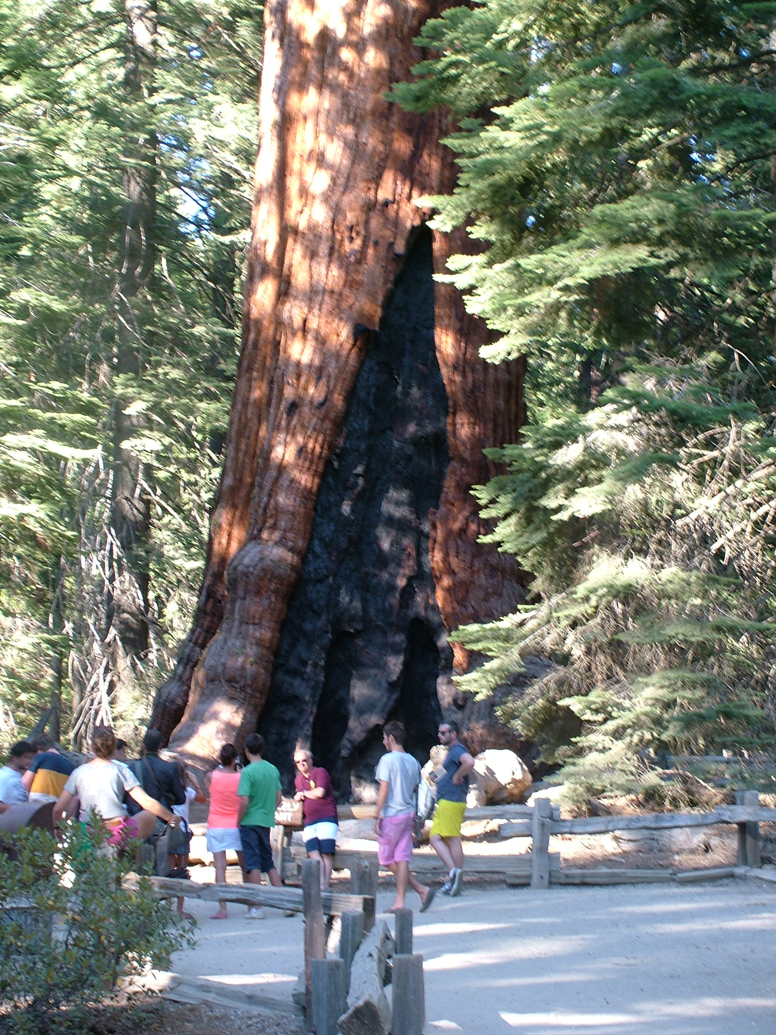
Giant trees and Monumental trees
Introduction
Maiores e mais velhos organismos na superficie da Terra. A presença de árvores gigantes ou monumentais melhora os ecossistemas terrestres à medida que as copas grandes aumentam a biodiversidade e parâmetros de biomassa (Franklin et al., 2002; Lindenmayer et al., 2012; Sillett et al., 2015; Sillett and Van Pelt, 2000; Van Pelt, 2001).
Aspecto turístico, potencial de $$$$, exemplo Sequoias (Lanner 2007; Sibley 2009).
Sequoiadendron giganteum
Notes:
which attract more than two million visitors a year in Sequoia and King Canyon National Parks (Strong 2000).

Slide 3
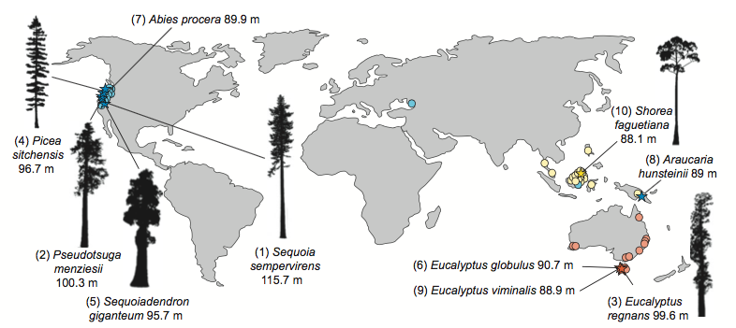
Giant trees and Monumental trees
Introduction
Giant trees are present all over the globe—except in the Antarctic continent — and are continually objects of interest to researchers who seek to record them for conservation programs and ecological (Tng et al., 2012; Van Pelt, 2001).
?
New Phytologist (2012) 196: 1001–1014

Slide 4

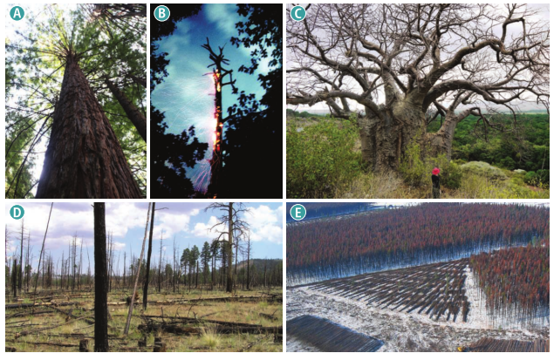
Introduction
Apresentam diferentes forma, tamanhos e idades no planeta.
Grande perda em razão do desmatamento e intensificação das catástrofes climáticas.
Notes:
which attract more than two million visitors a year in Sequoia and King Canyon National Parks (Strong 2000).

Slide 5

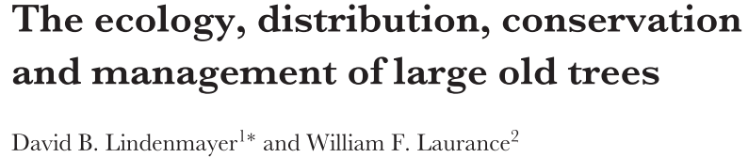
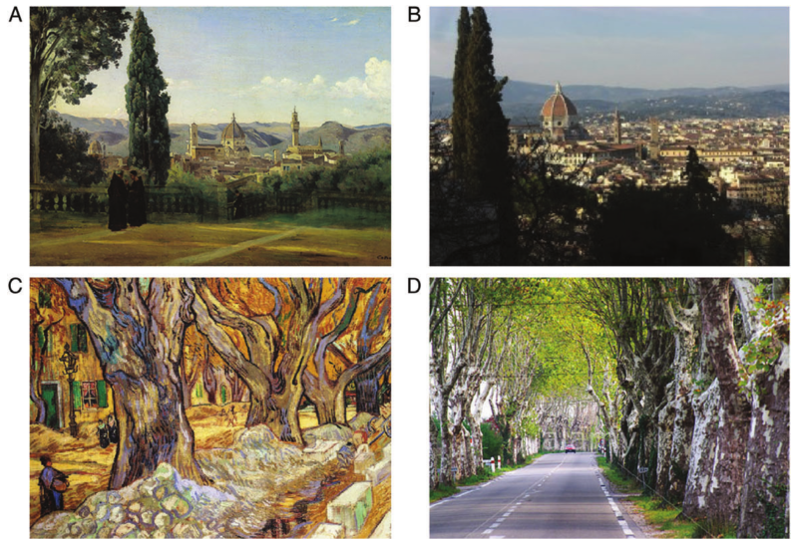
Significant artworks featuring trees and modern-day photographs of their locations in Europe, North America and Asia. (A, B) Camille Covet’s Florence vue depuis les jardins 1835 and image of modern-day Florence, Italy from the Bardini garden (photograph by G. Icoges); (C, D) Van Gogh’s Large Plane Trees 1889 and a modern-day tree-lined stretch in Saint-rémy-de-provence, France(photograph by S. Alamy)...

Slide 6
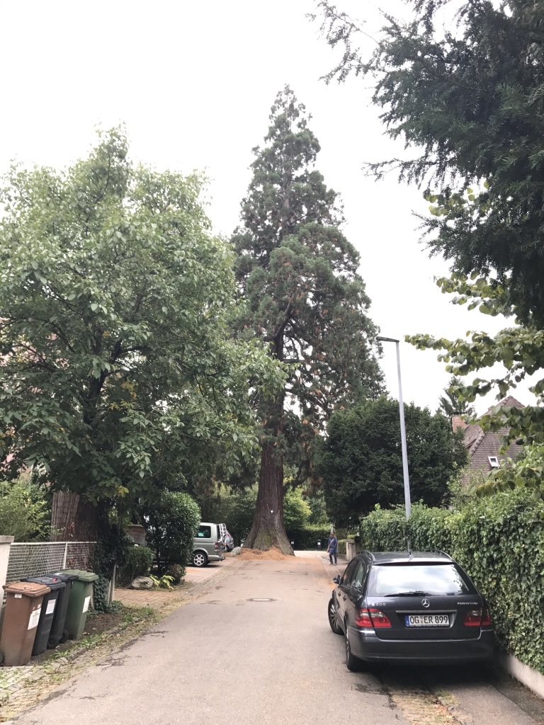
Sequoia – Freiburg- Alemanha

Slide 7
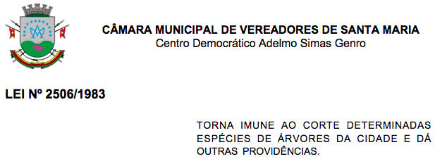
Árvore imune ao corte
Código Florestal
Art. 70.
II - declarar qualquer árvore imune de corte, por motivo de sua localização, raridade, beleza ou condição de porta-sementes

Slide 8
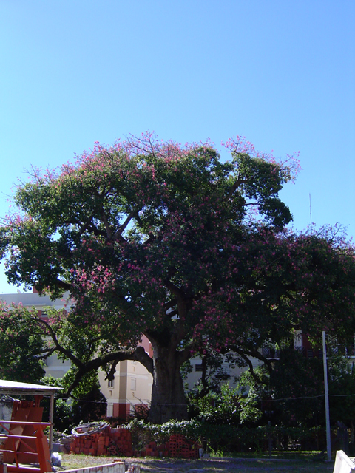
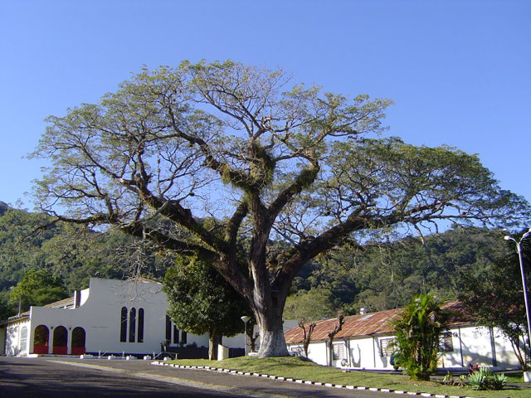
Timbaúva - em frente ao Clube Esportivo, na rua Casemiro de Abreu, nº 59, Santa Maria, RS.
LEI Nº 2506/1983
Paineira - Conde de Porto Alegre, Santa Maria, RS.

Slide 9
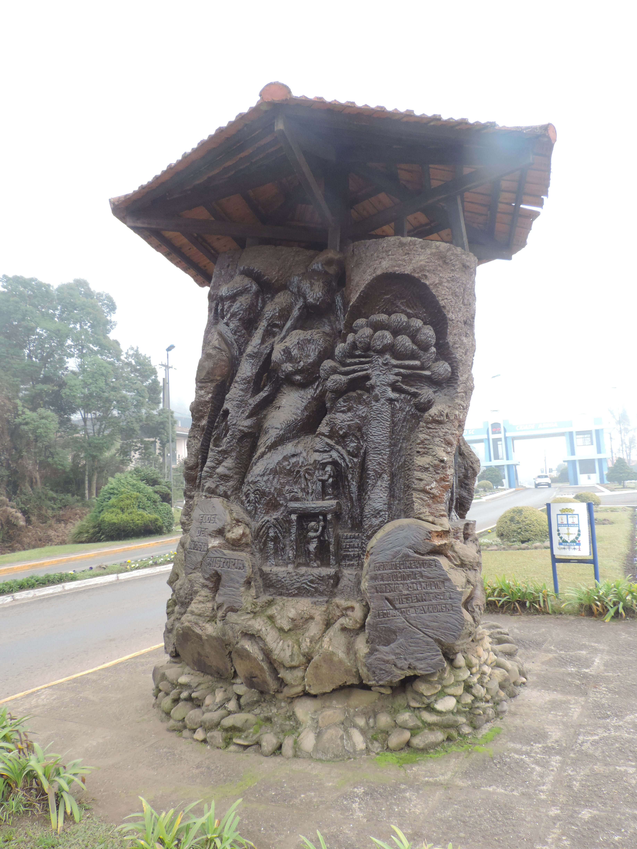
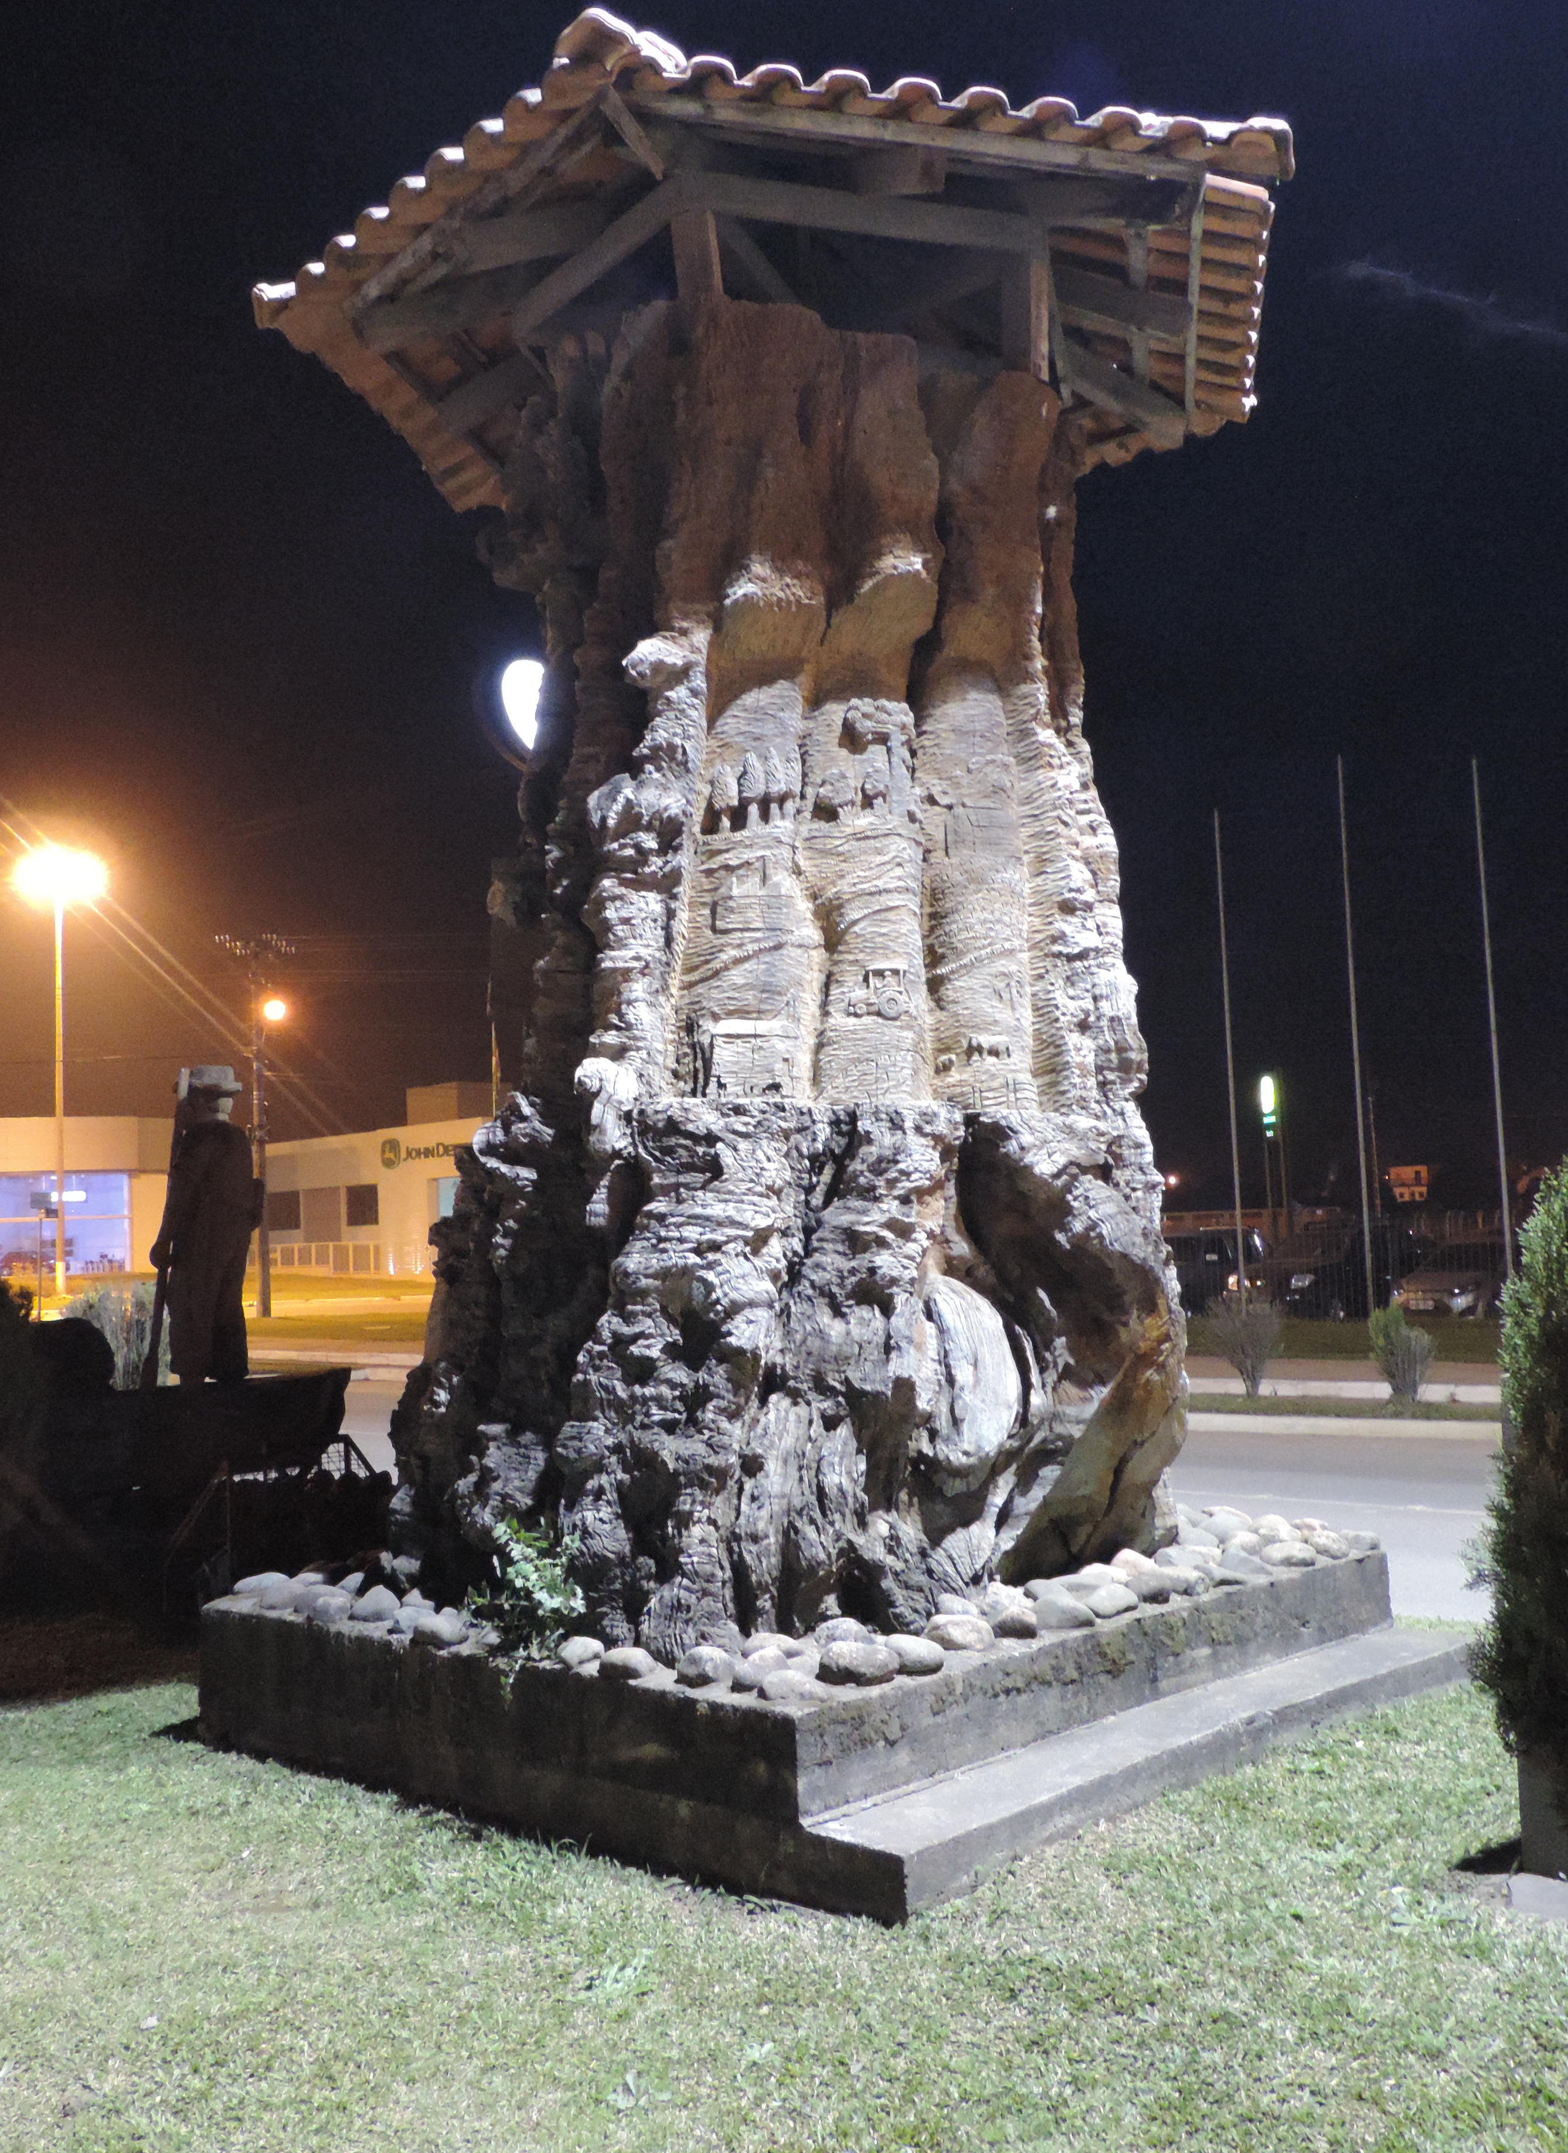
Árvores tombadas?
Porto União - SC
Canoinhas - SC

Slide 10
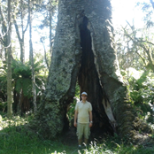
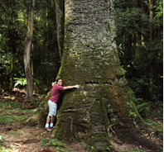
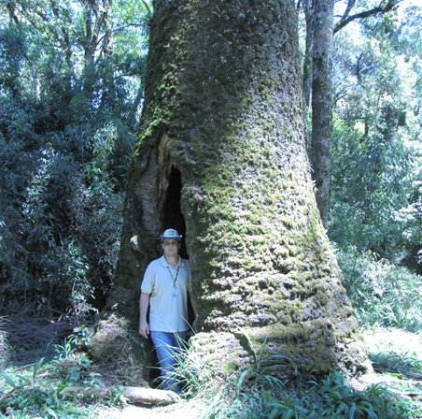
Introduction
Onde estão as maiores árvores?
São monumentais?
The objective of this study was to catalogue the largest A. angustifolia individuals and to detect their rarity and size compared to araucarias on the inventories of Rio Grande do Sul and Santa Catarina states.
Aljos Farjon
Accepted Publication: Scientia Agricola, 2017
Notes:
After returning from a visit to Sequoia Park in the USA in 2012: I wondered where are the biggest trees in Brazil? So I started cataloging and registering the largest trees southern Brazil. The first species of my study is the Brazilian pine or Araucaria.

Slide 11
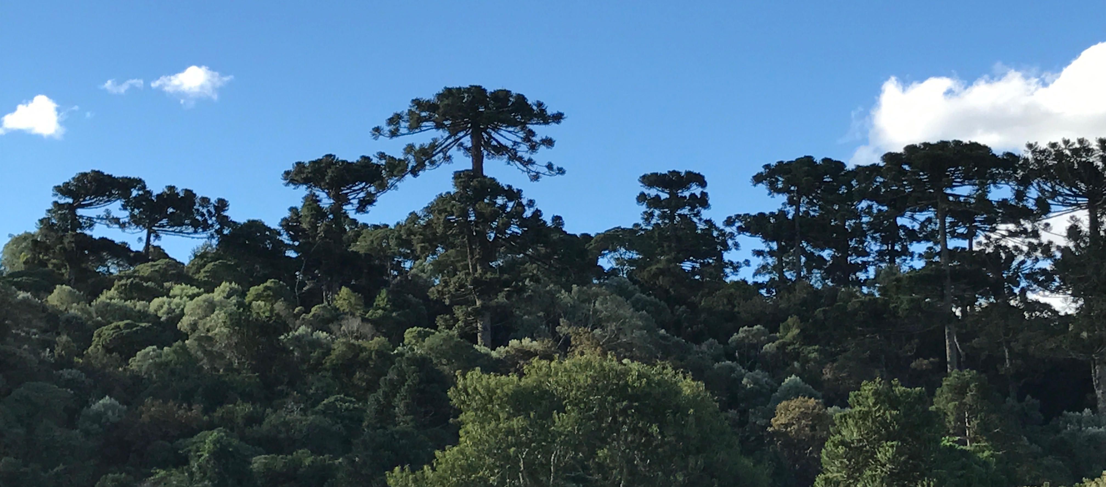

Pinheiro-brasileiro
Introduction
Notes:
The long history of human activity in its area of occurrence, since the first human settlements in the region, changed the population structure of the species in different ways, whether by seed collection or logging (Souza et al. 2008). The greatest drastic reduction of the Araucaria forest was during the 20th century being one of the most threatened forest formations in Brazil (Carvalho and Nodari 2010). At the beginning of the 20th century, there were approximately 25 million hectares of Araucaria Forest. The high value of A. angustifolia wood led to extensive exploitation of forests, reducing them to 12.6% of their original area (Ribeiro et al. 2009). Most of the remaining forests are composed of small fragments smaller than 50 hectares (~ 79%), located on private land, and only 3.1% of the forests are under legal protection (Ribeiro et al. 2009). Logging of A. angustifolia and other endangered tree species has been prohibited by federal law in 2001 (Brasil 2001). Although intensively exploited, this forest type remain little known. Knowledge about ancient trees in this environment are even more scarce (Mattos 2011).
In this scenario, the general objective of this study was to catalog the largest Araucaria agustifolia individuals. To do so, we sought to discover their locations in southern Brazil and to record their dendrometric information by categorizing the largest individuals and estimate their ages. Noteworthy is that there is no specific studies related to the inventory of giant araucarias in Brazil. Therefore, because of the lack of information, conducting this research is fundamental for the development of conservation and management actions and policies, as well as to encourage the nature tourism, promoting the visitation and environmental education through these giant trees.

Slide 12
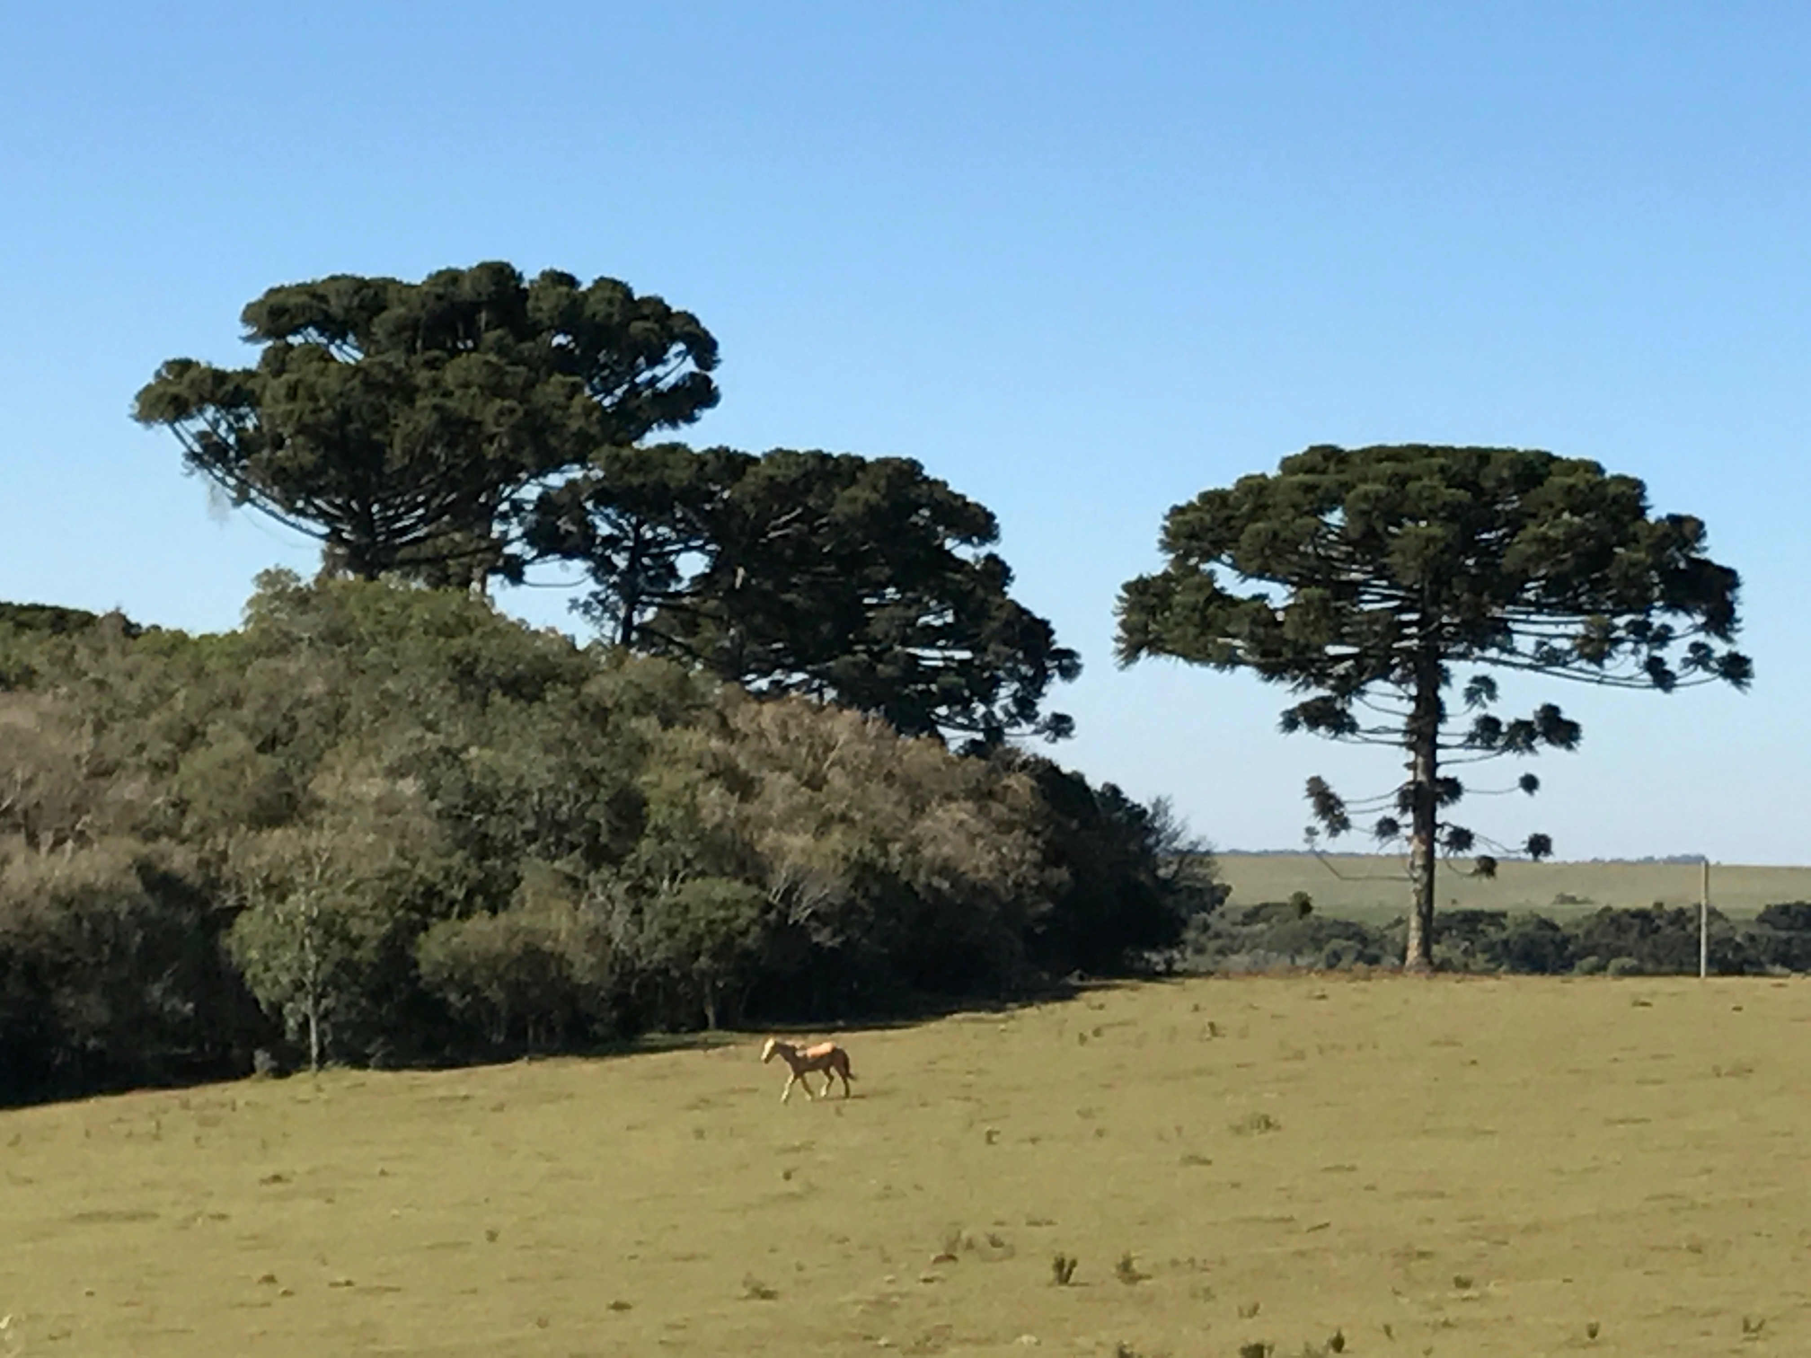
Pinheiro-brasileiro
Materials
and
Methods
Araucaria angustifolia - Araucariaceae, (Brazilian pine or Paraná pine) dominate the canopy or even surpass widely the canopy as emergent trees, and mature trees are among the largest trees in Brazil (Oliveira et al., 2009).
In this moment, the species is critically endangered (Thomas, 2013) and little is known about the existence and condition of these long-lived trees.
12.6% original area (Ribeiro et al., 2009).

Slide 13
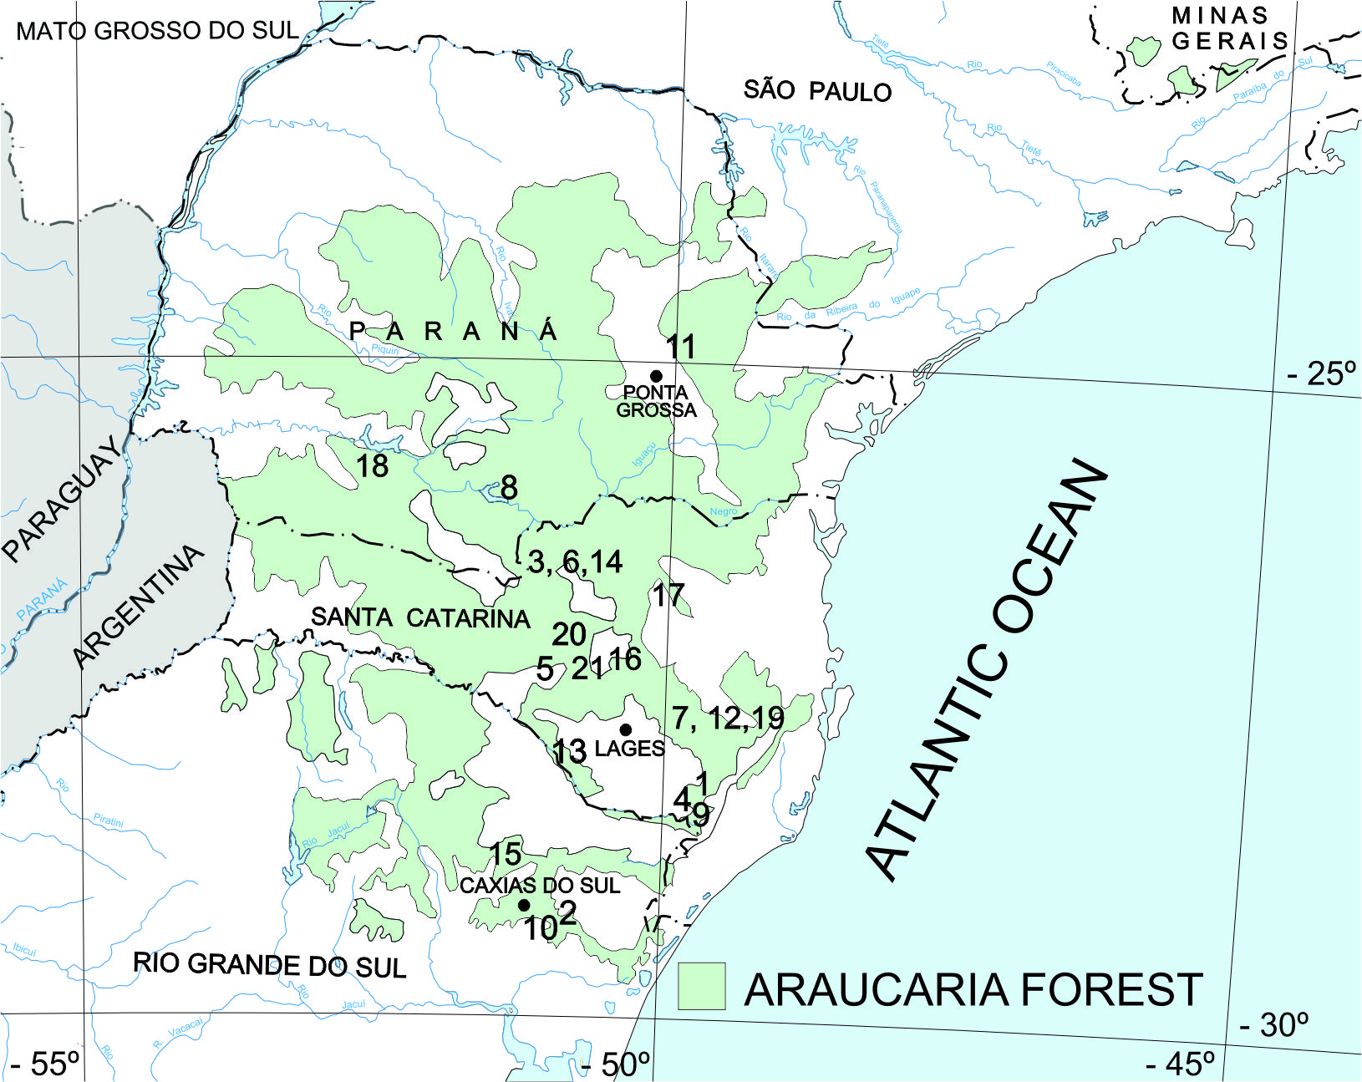
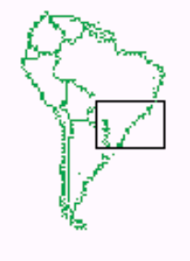
Materials
and
Methods
Plateau of Brazil, in the northwest of Argentina, and in the southeast of Paraguay between 400 m and 1800 m above sea level.
Mature individuals are between 20 and 50 m in height 0.5 to 2.4 m in diameter.
(Albiero Jr. et al., 2015; Eckenwalder, 2009; Farjon and Filer, 2013; Oliveira et al., 2009)

Slide 14
Study area
The research was conducted over a three year period
published bibliographies (Albiero Jr. et al., 2015; Chassot et al., 2011; Farjon and Filer, 2013; Mattos et al., 2007; Mattos, 2011; Narvaes et al., 2005; Scheeren et al., 2000; Stepka et al., 2014) and reports.
online platform (www.arvoresgigantes.org)
personal networks
More than 6,813 km (4.233 Miles)
I visited seventeen rural properties and twelve different types of conservation units:
Private Nature Heritage Reserve - RPPN (2),
Indigenous Reserve (1),
National Forests (3), and Municipal (2), State (1) and National (4) Parks.
Materials
and
Methods

Slide 15
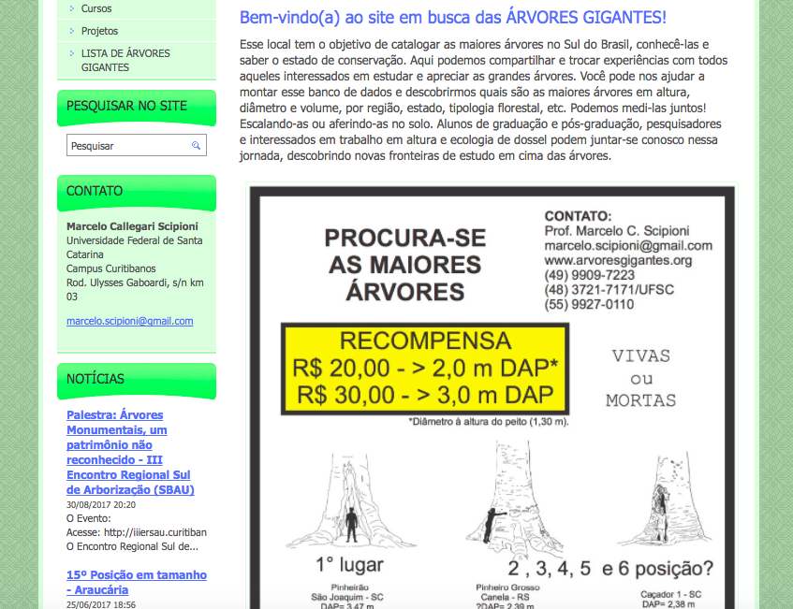
The research was conducted over a three year period
published bibliographies (Albiero Jr. et al., 2015; Chassot et al., 2011; Farjon and Filer, 2013; Mattos et al., 2007; Mattos, 2011; Narvaes et al., 2005; Scheeren et al., 2000; Stepka et al., 2014) and reports.
online platform (www.arvoresgigantes.org)
personal networks
Materials
and
Methods

Slide 16
State Forest Inventories
Data from the state forest inventories of Rio Grande do Sul and Santa Catarina were consulted to check the existence of large trees of A. angustifolia and to help in the search for places in good state of conservation to research.
The DBH and height of the giant araucarias were compared with all araucarias measured (DBH > 10 cm) on the inventories of Rio Grande do Sul and Santa Catarina states (3,529 araucarias).
Materials
and
Methods

Slide 17
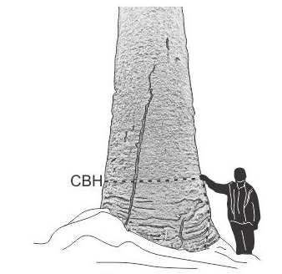
Dendrometry
- The circumference at breast height (1.30 m), the total height, and the volume were measured following methodologies in Van Pelt (2001). Measuring tape and dendrometers (Trupulse 200 B and Criterion 400, Laser Technologies, Inc.) were used.
- The total tree volume consisted of the sum of the main trunk volume and the reiteration trunk volumes.
- The cavity areas at the base of the tree trunk were measured using metric tape and laser equipment (Trupulse 200 B).
Materials
and
Methods
Notes:
We also measured the height at which the secondary branches (reiteration trunks) intersected the main trunk. We calculated trunk volume using the Smalian method and included diameters of extremities in each section. The Huber method was used only for reiteration trunks; a single diameter reading was taken in the centre of the section.
Araucaria angustifolia trees that had overlapping canopies were difficult to measure as trunks were visually obscured. The volumes of these trees were estimated by means of an average artificial form factor based on 8 studied trees above two meters in diameter (Figure 2). Total heights of these trees were measured using Trupulse positioned on ground level creating a 90° angle, targeting the top of highest branch. For trees with a damaged crown, measurement of the main trunk together with the height where the fallen secondary branches intersected the main trunk were used to estimate the total height.
In cavities large enough for a person to stand in, basal area measurements of the cavity were calculated by measuring eight radii from the central axis of the tree. The height of the cavity at the central axis was measured by taking the vertical distance with a survey laser. Photographs of the trunk base were taken in order to create drawings to represent tree scale. The illustrations of the tree bases included a profile of a person 1.8 m tall to show scale. The images were handled in Photoshop and those drawn in CorelDraw X6™ software (Van Pelt, 2001).

Slide 18
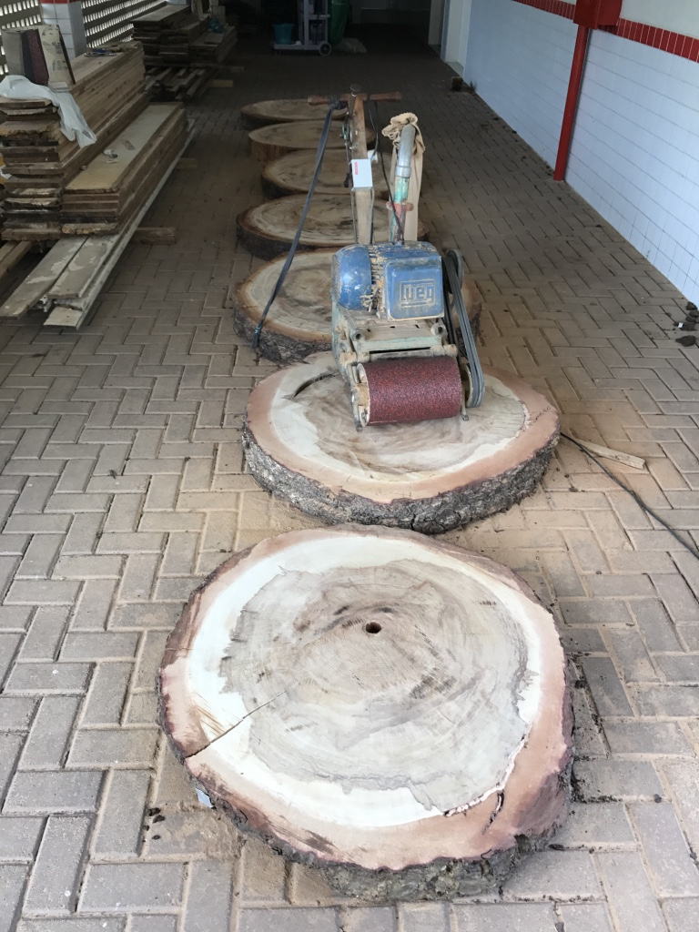
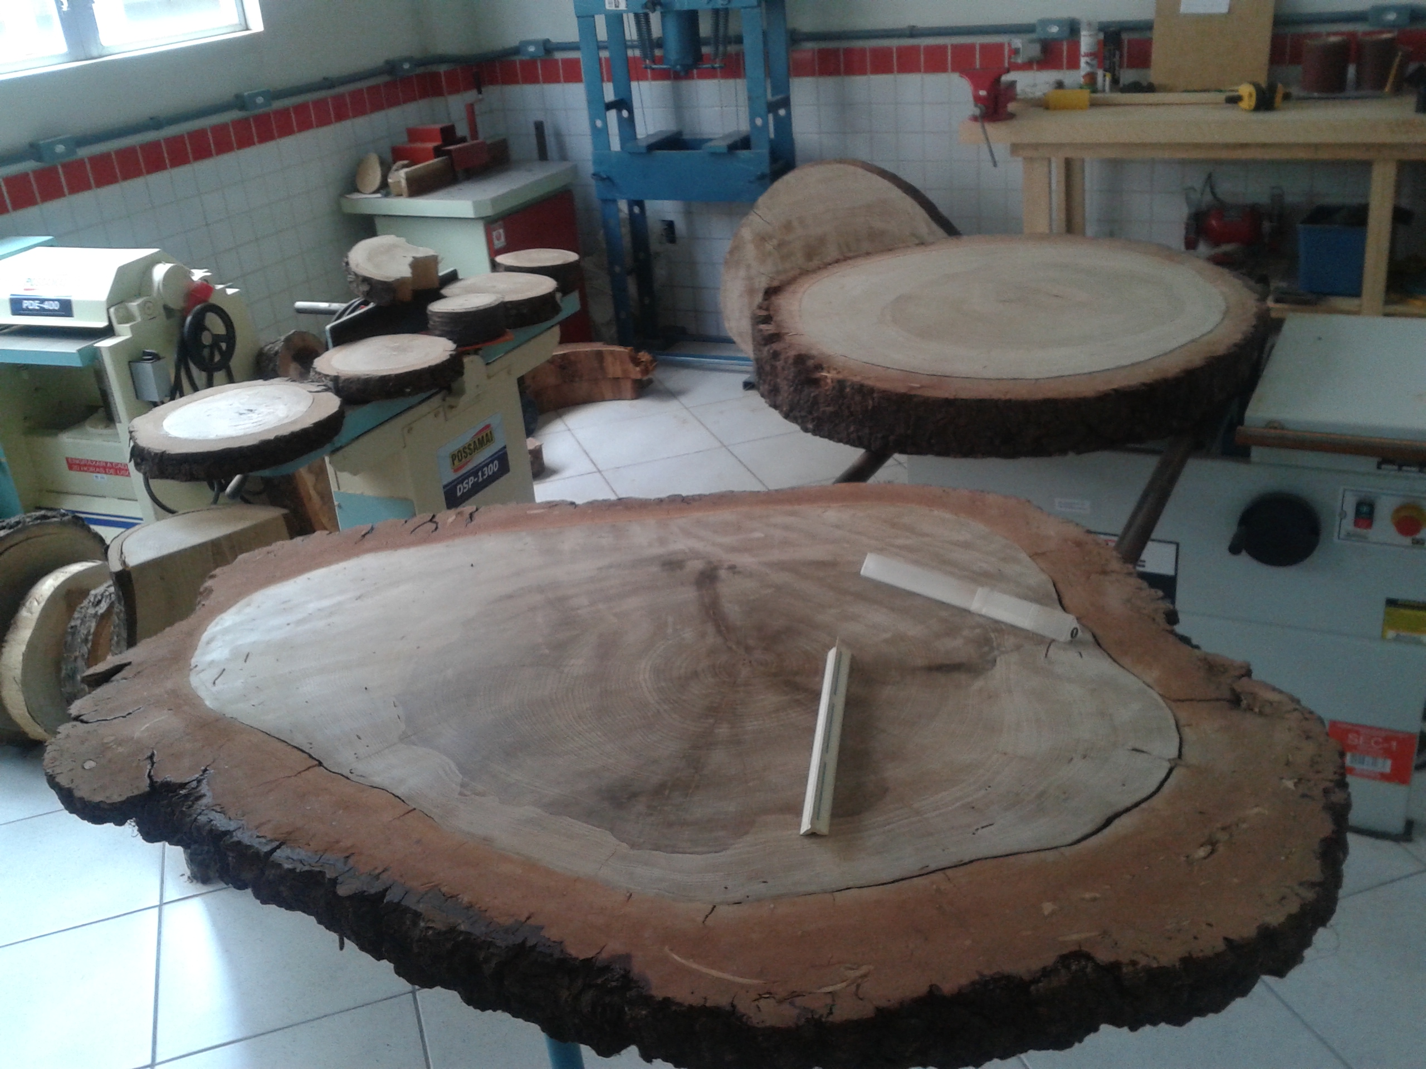
Dendrochronology
We measured the periodic mean increments of annual growth rings in a cross-sectional sampling of a dominant tree to estimate A. angustifolia ages.
We had permission to destructively sample a relatively large tree.
We then calculated the mean radial increment, which was transformed into diameter at 50-year intervals. Growth rings were counted on the disc collected at the base of the tree (h = 0.1 m).
Materials
and
Methods

Slide 19
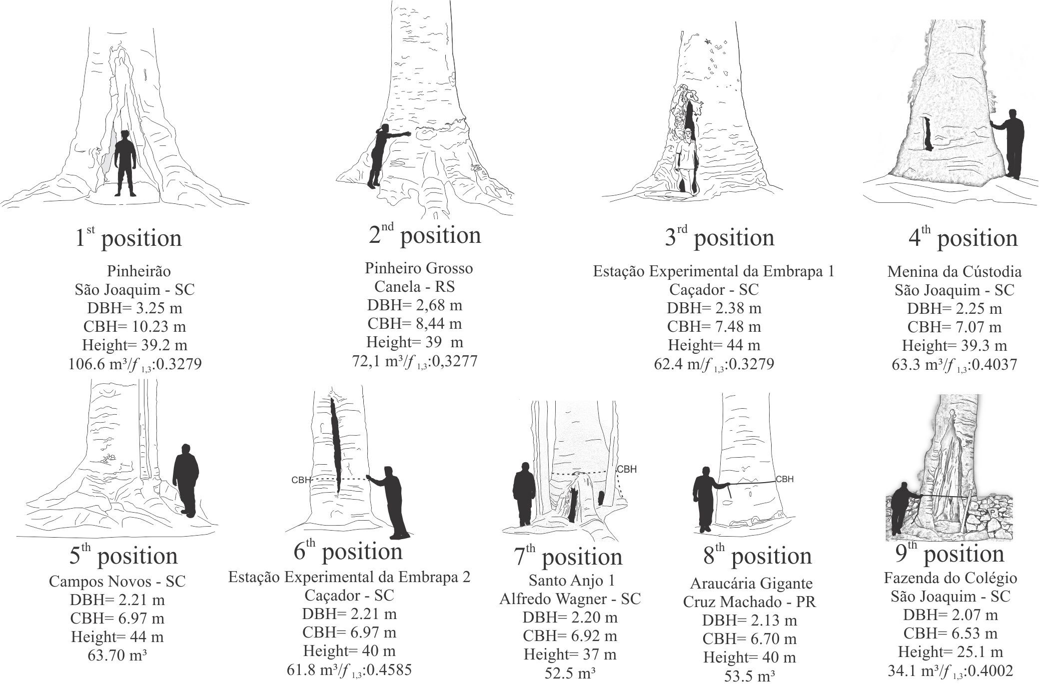
Results
www.arvoresgigantes.org

Slide 20
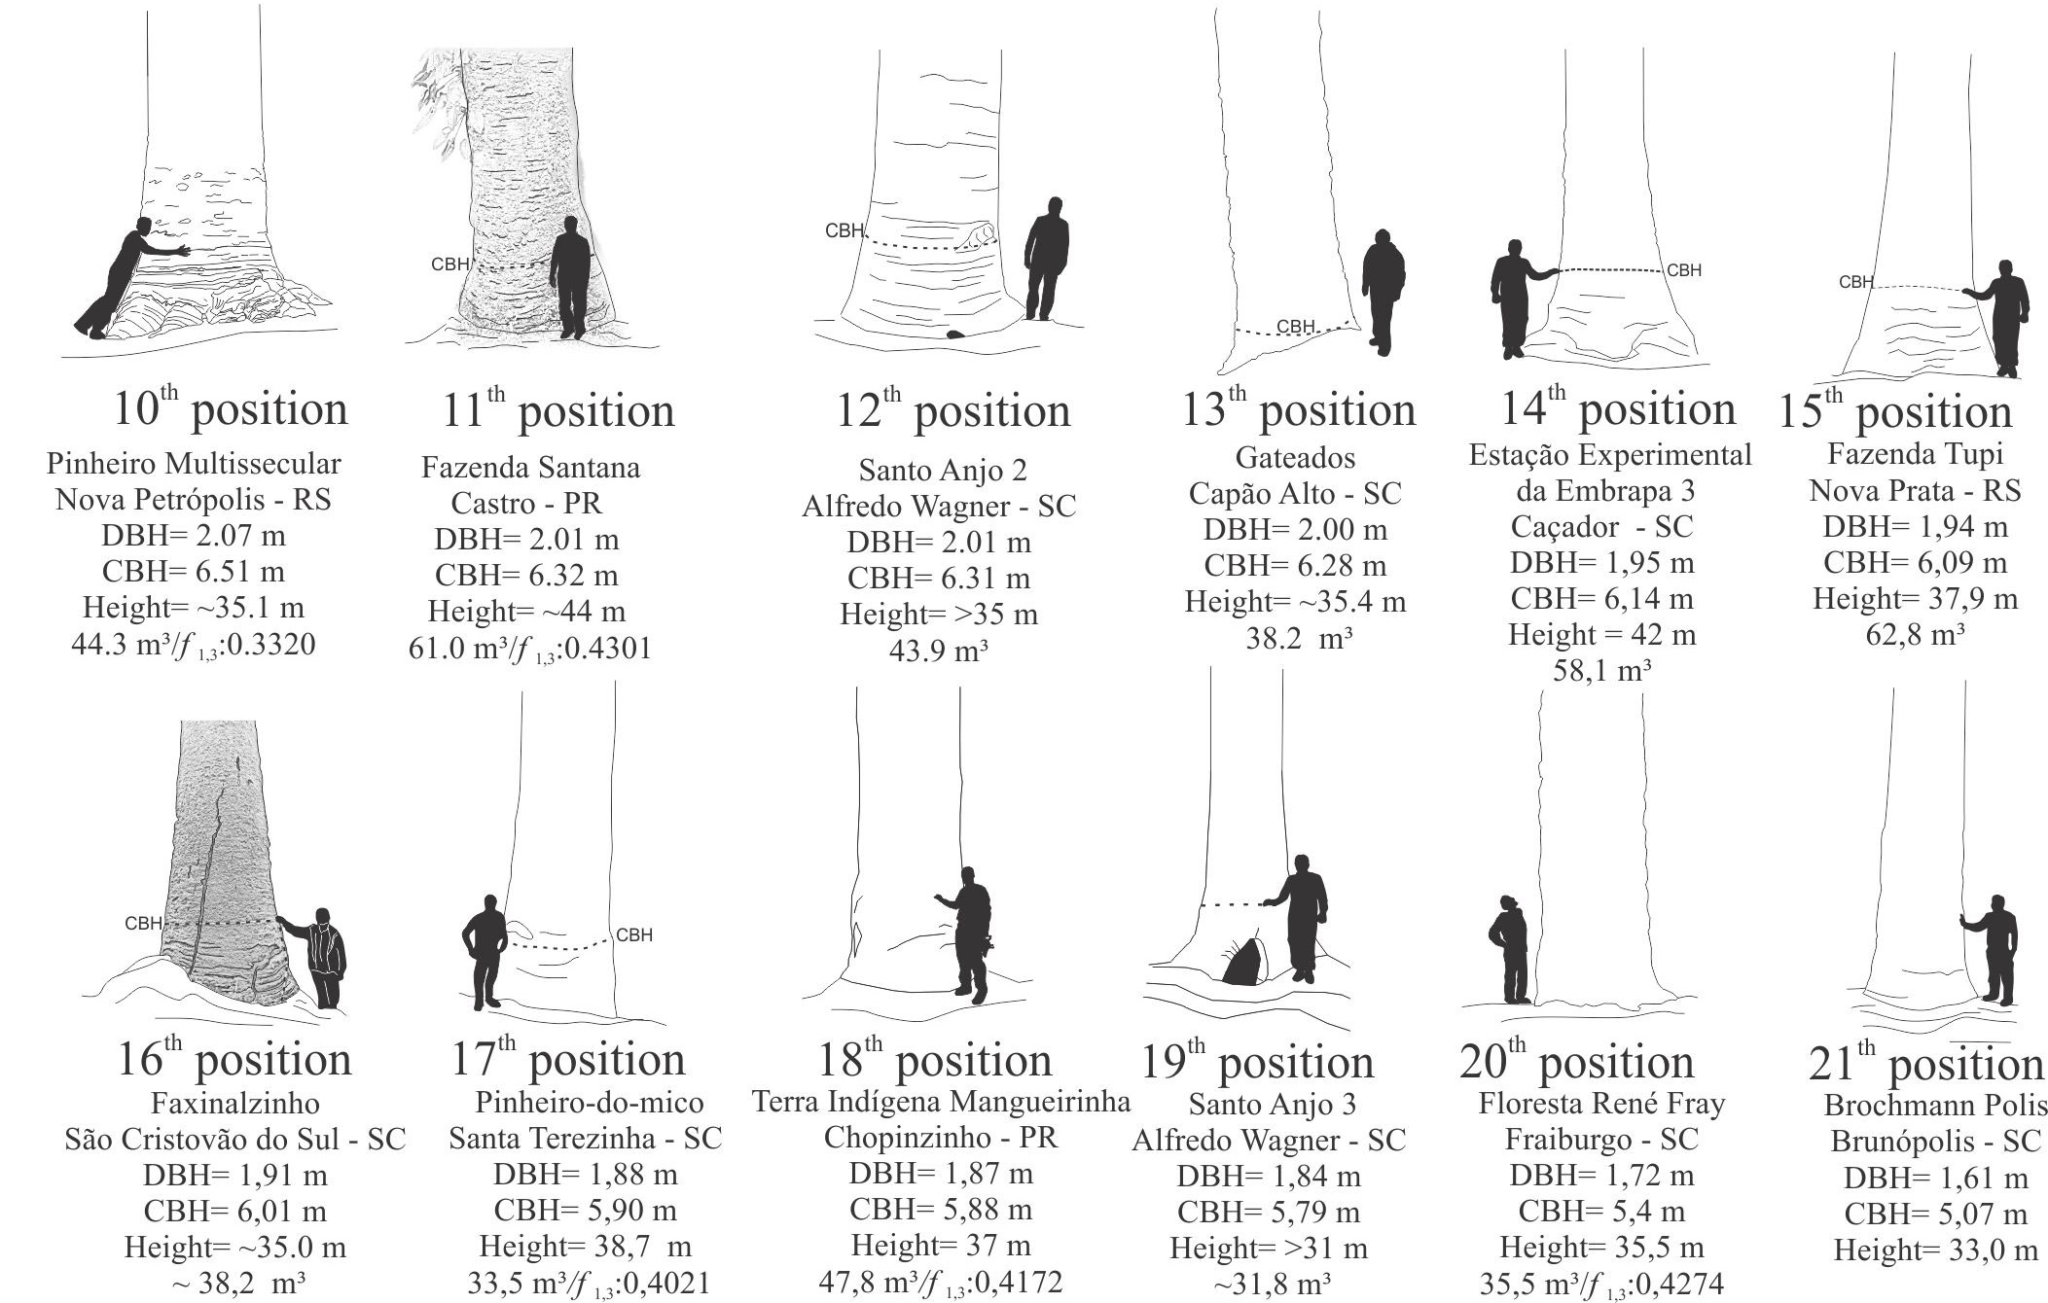
Results
www.arvoresgigantes.org

Slide 21
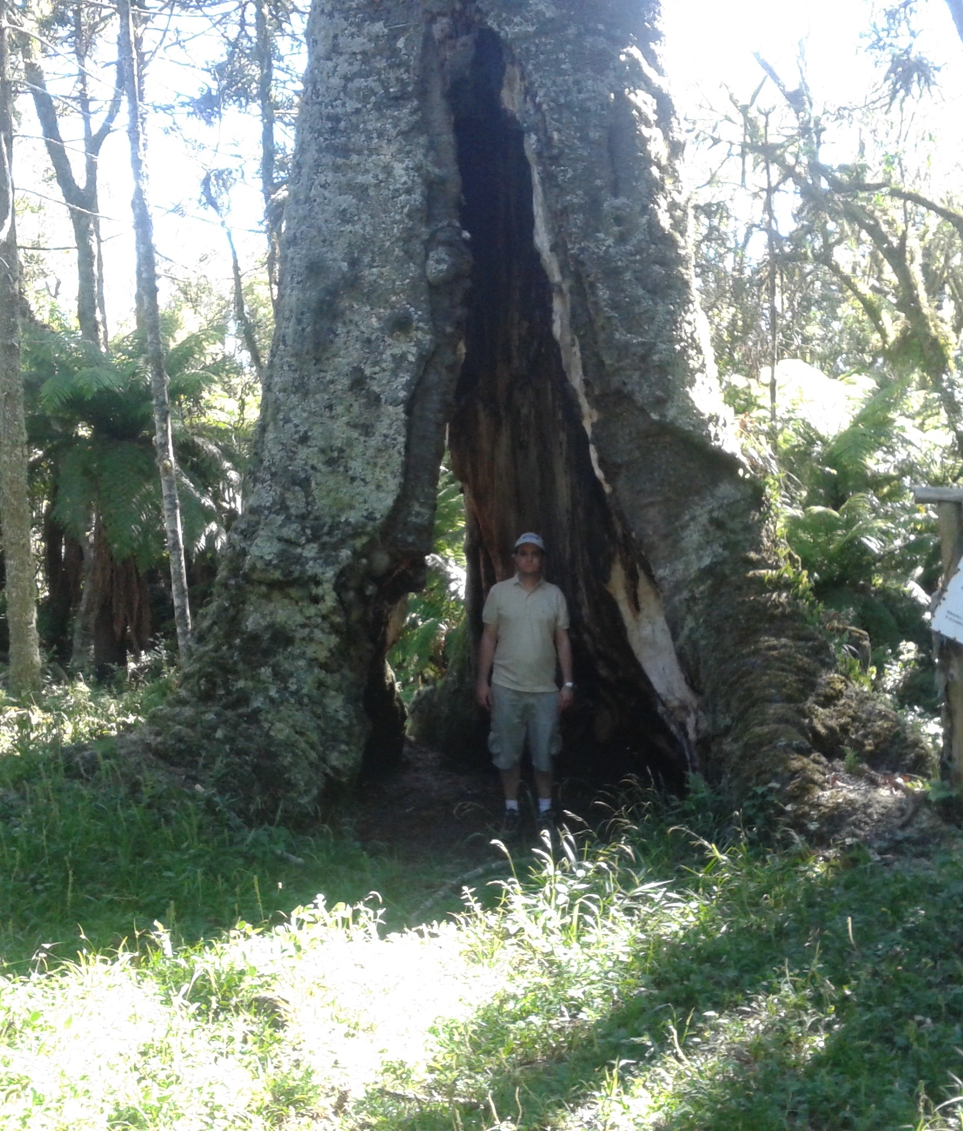
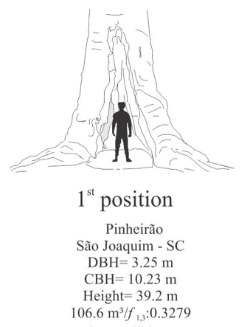
Pinheirão – number one
Results
The cavities made this tree undesirable to loggers who exploited the same area located in São Joaquim (SC) in four annual cutting cycles until the early 1980s.

Slide 22
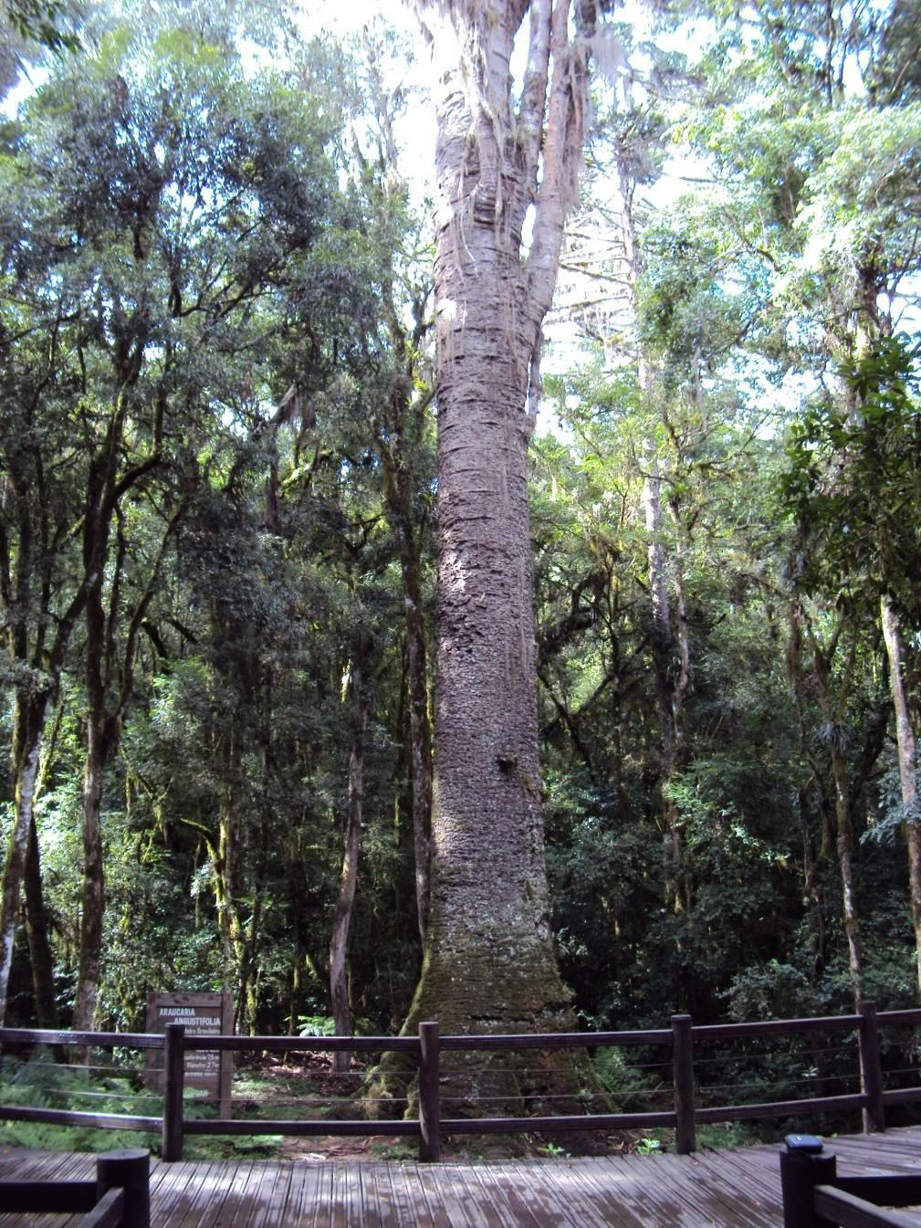
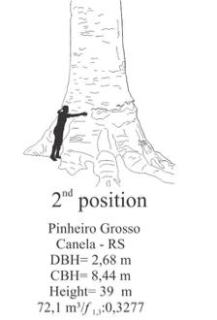
Pinheiro Grosso
Results
The ‘Pinheiro Grosso’ is located in the Pinheiro Grosso Municipal Park. It is the only tree among the giant araucarias that has a complete tourist infrastructure and is the best known and most visited tree.
This tree is visited by more than 13,000 people per year.

Slide 23
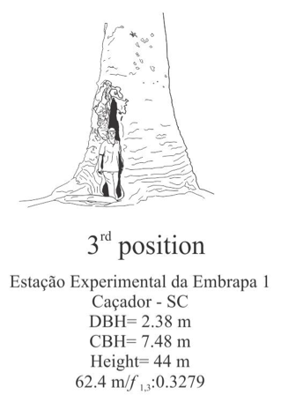
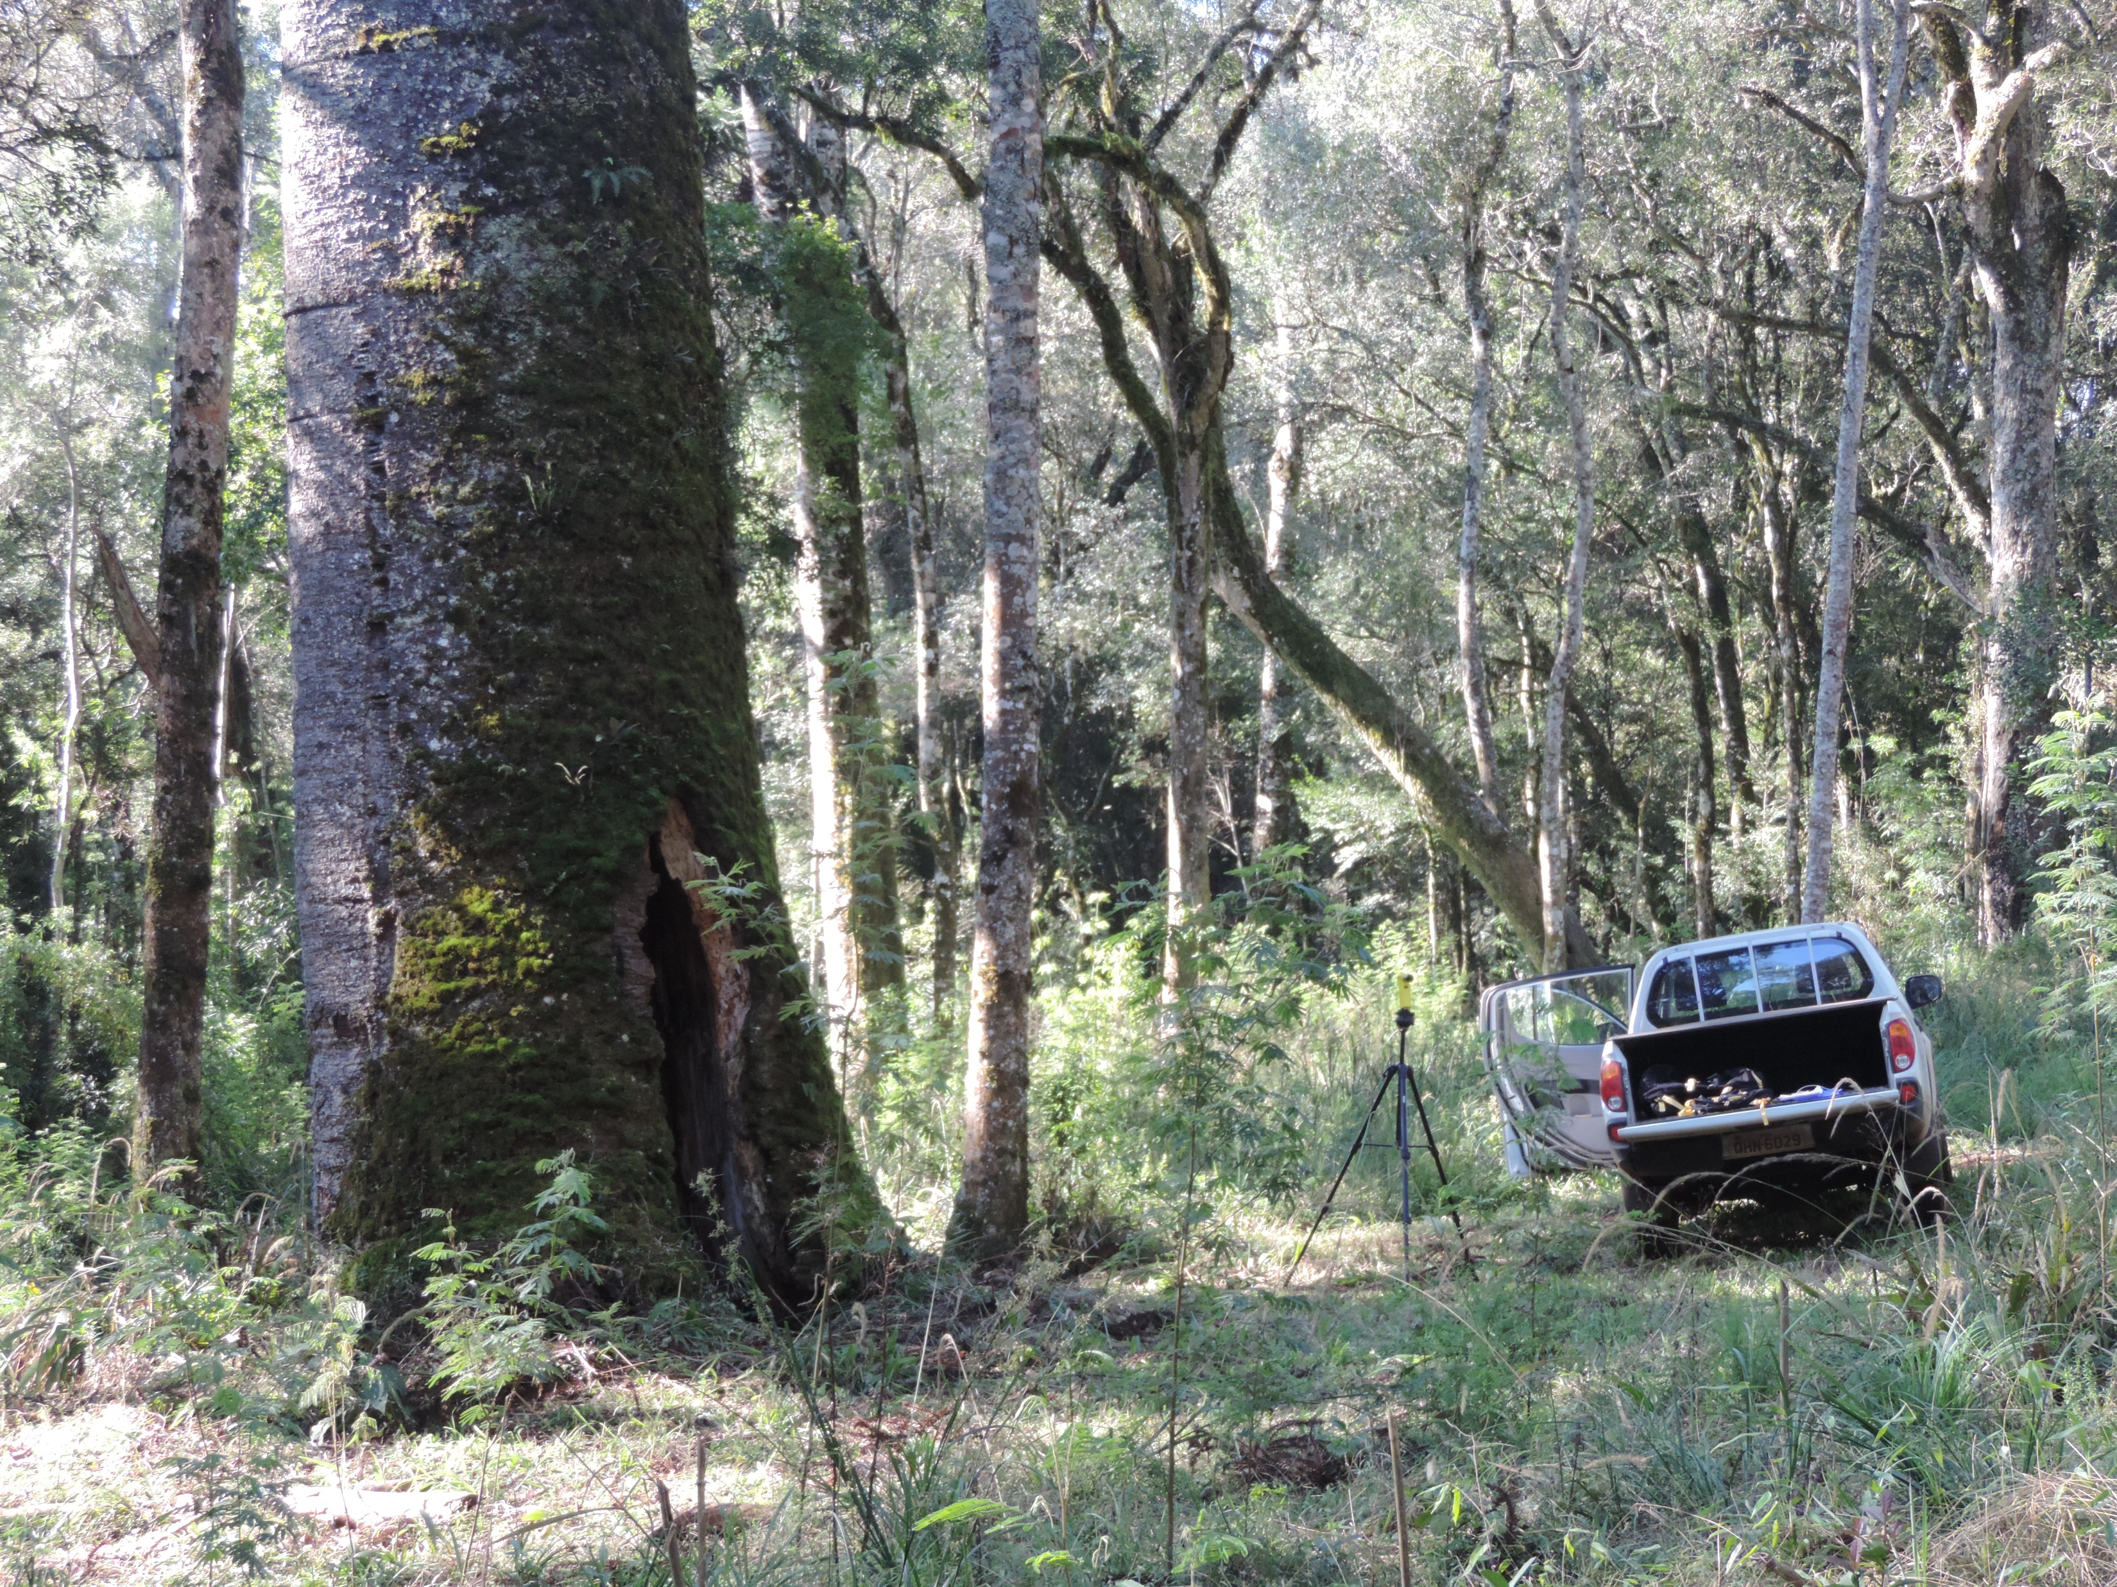
The third largest araucaria Caçador
Results
The site is a forest fragment with a history of intense human exploitation that contains two giant trees, one of which is listed in this study.
This close proximity between these two trees ( 6 e 14 position) prompts us to speculate that in the past these large trees were more common and could be found at high frequencies.

Slide 24
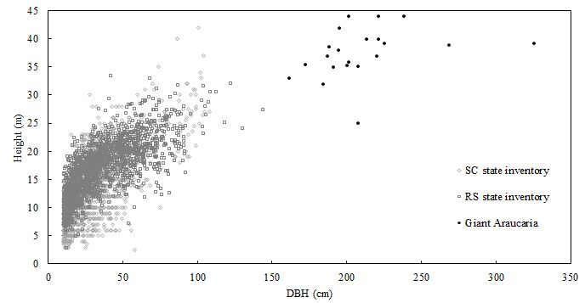
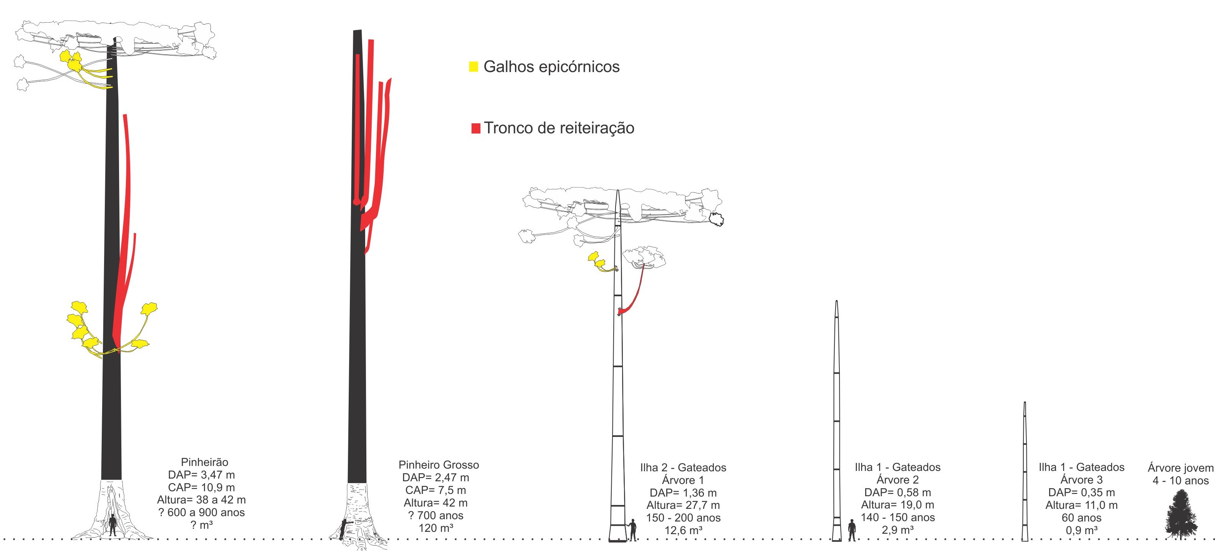
In the inventories of Rio Grande do Sul (RS) and Santa Catarina (SC) states, 1,810 and 1,697 araucarias were measured, respectively. The largest araucarias showed 144 cm in DBH in RS and 108 cm in SC.
Results
SC
RS

Slide 25
The late legal protection of araucaria (Brasil, 2001) and the small number of trees protected by landowners are probably the cause for the few number of remaining giant araucarias.
Results
This is a monumental tree, the only living proof of the potential growth and longevity in the species.
The volumes of these old trees are very large, ranging from 38.2 m³ to 106.6 m³.
Giant Araucarias
Notes:
Data presented in reinforce:
the difference between tree sizes detected in systematic surveys like state inventories (so large that exempts a statistical test)
the rarity of the individuals sampled in the present study, thus providing a robust argument for the ‘giant’ nomenclature.
the absence of araucaria individuals with DBH larger than 150 cm in both state inventories demonstrates the diametric distribution imbalance of forest remnants in southern Brazil.
I only found giant trees located in old forests with very low historical anthropic action in three places (Gateados, Santo Anjo and Fraiburgo).

Slide 26
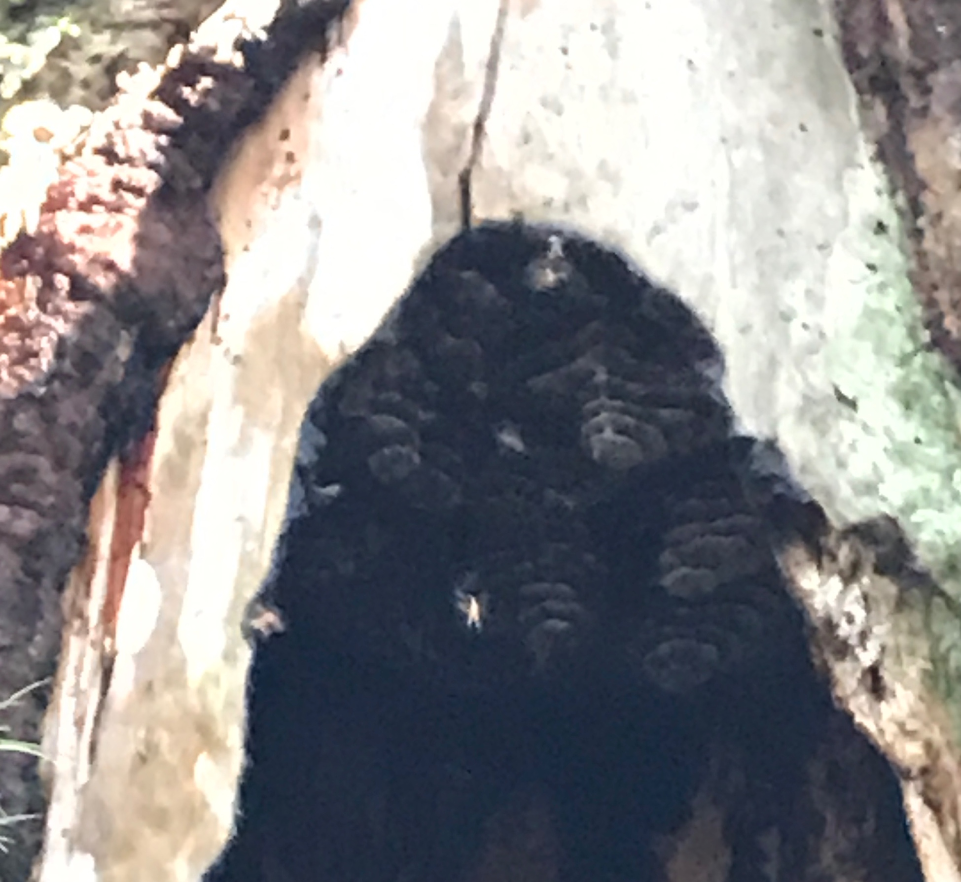
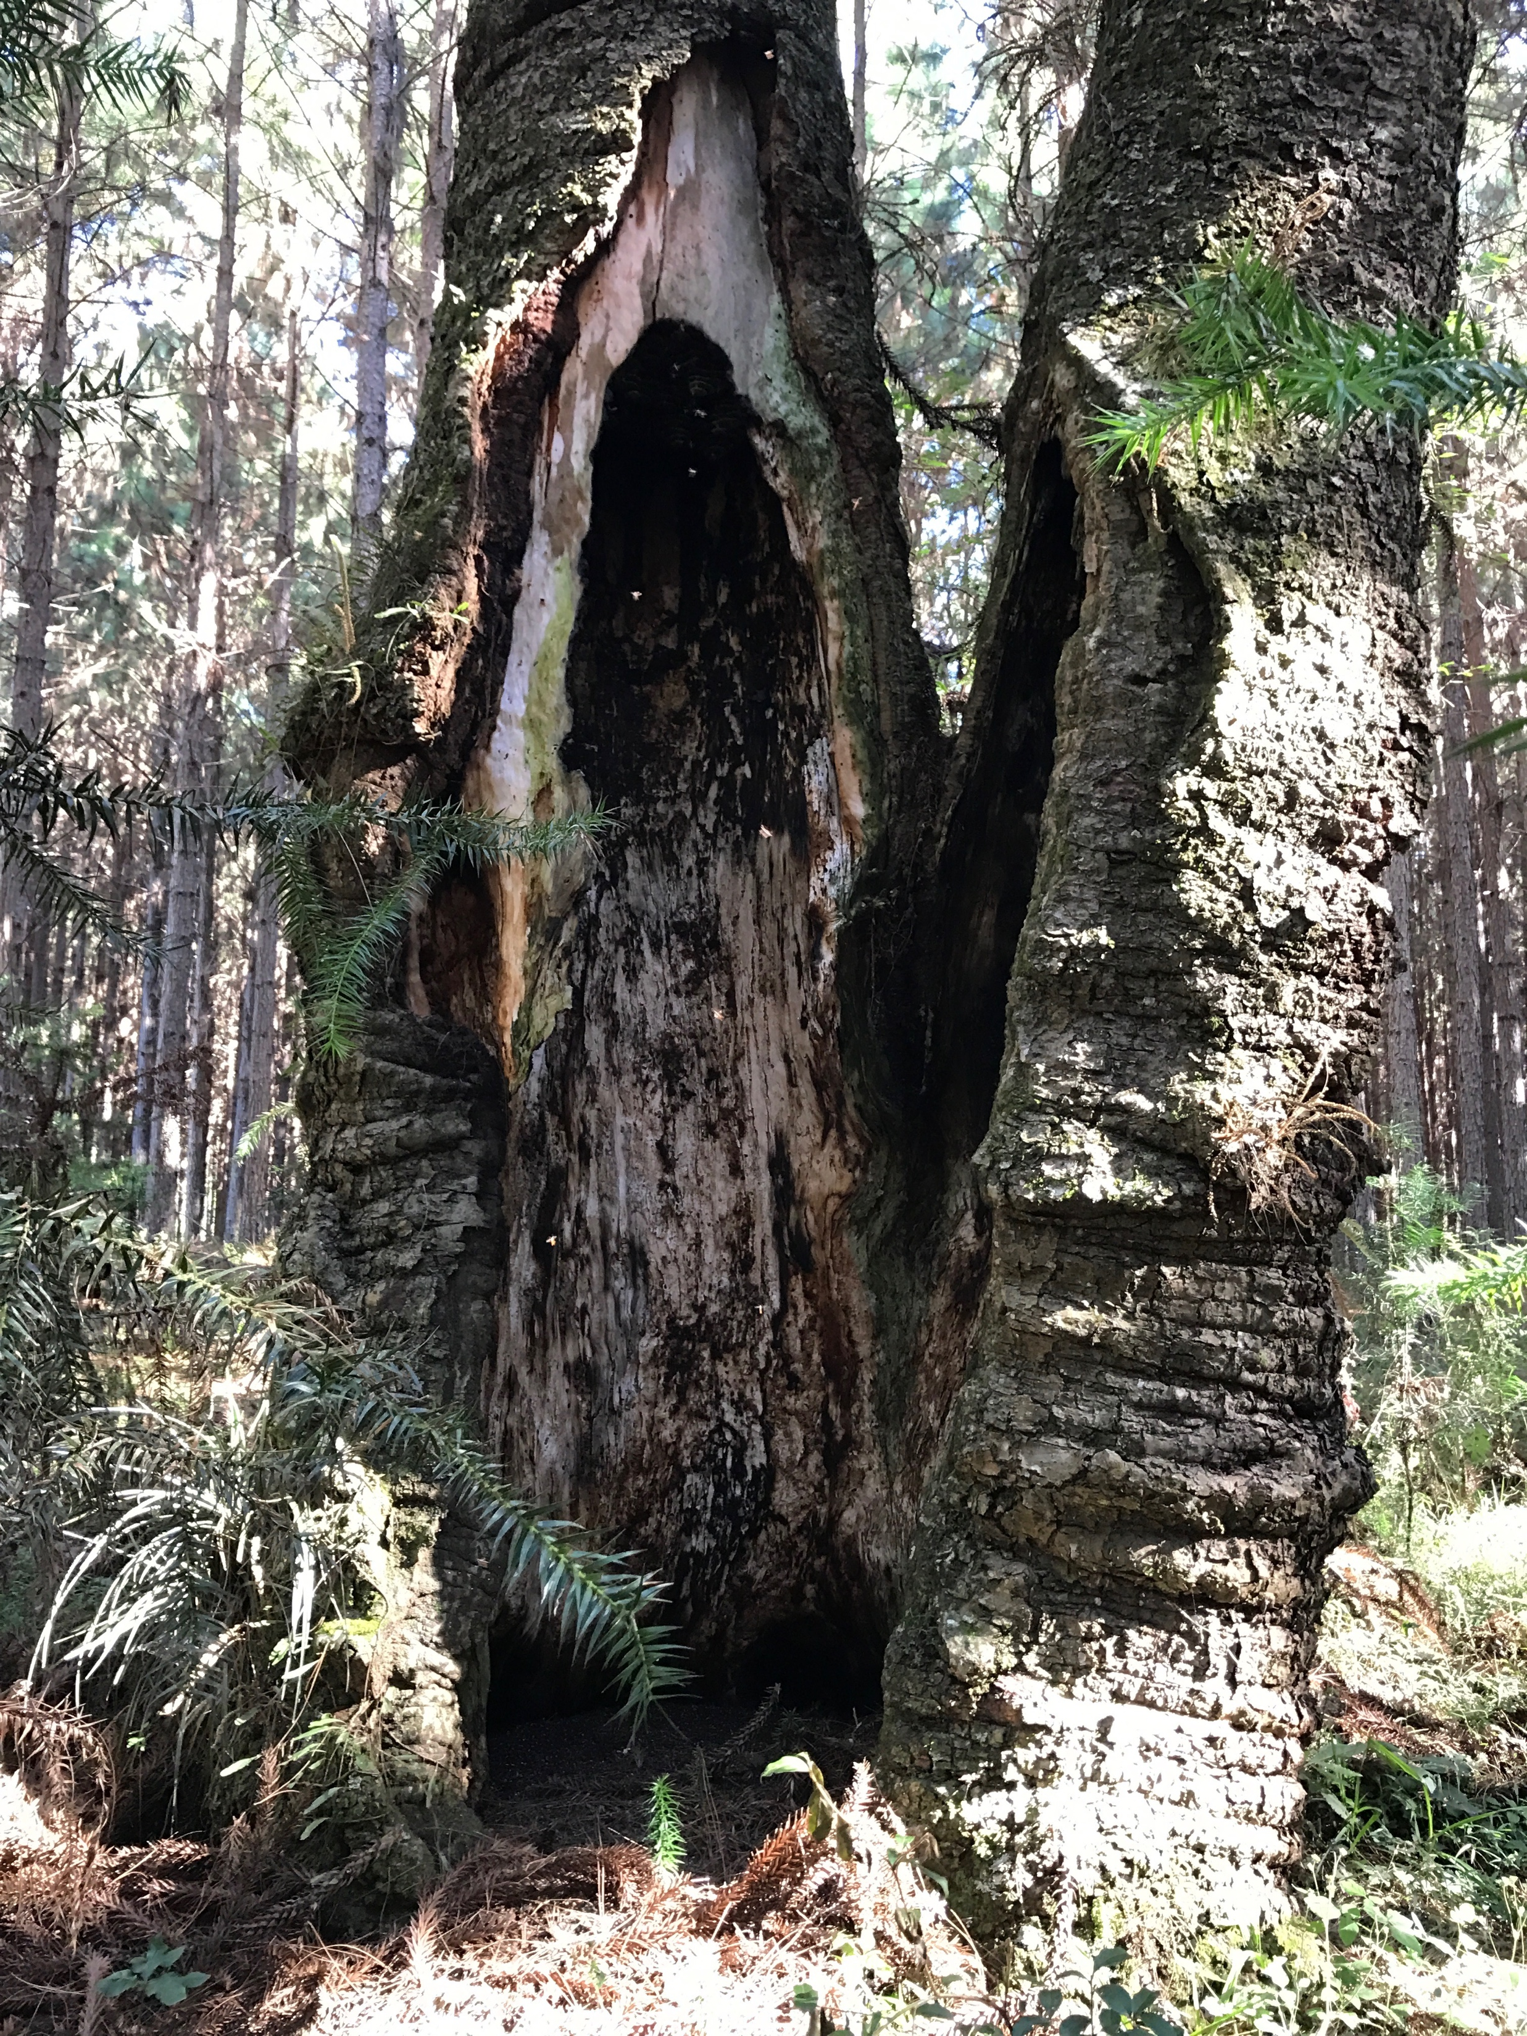
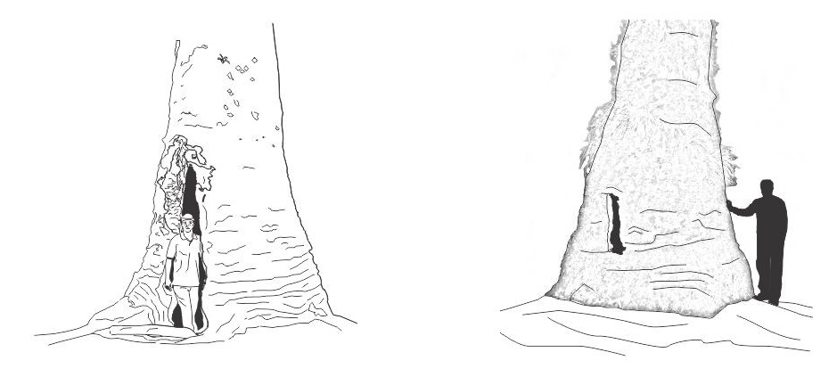
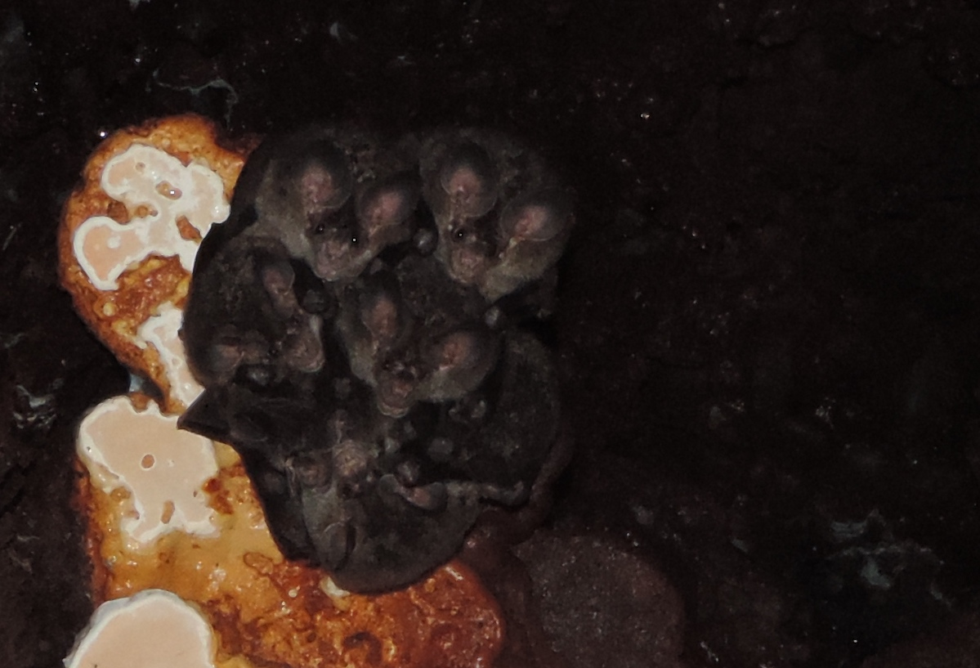
Results
The cavities made this tree undesirable to loggers.
However, it is important by other life forms...
INSECTS
WASHER AND BEES
MAMMALS
BATS
biological cave
natural cavities
man-cavities

Slide 27
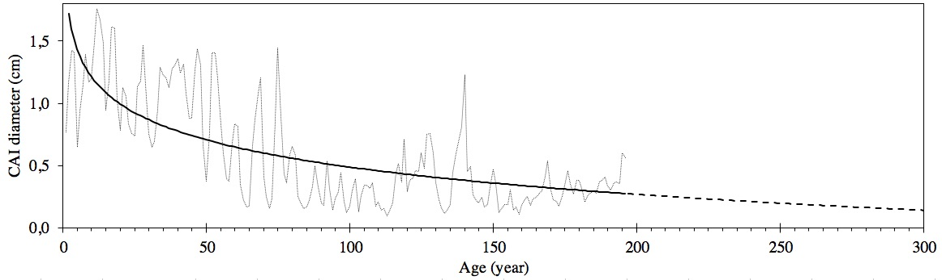
How old is the araucaria giant?
Results
The average annual increment in tree diameter evaluated in our study was 0.585 cm year⁻¹, with substantial variation depending on the life stage of the tree.
Current annual increments measuring 0.167 cm in diameter in DAP are expected from age 300 onward.
We need partners…
Notes:
Current annual increments and trend line for growth in diameter (DBH = 112 cm). The solid line represents the period with observed data for the trend adjustment (196 years), while the dashed line shows the projection of the trend for the next century. The growth trend is given by the equation ${CAI}_{dbh}=1,942−0,316 ln\left(age\right)$, R²=0.499 e S_{yx}=51.7%.
In Table 1 we report that tree age estimates vary depending on the age analysed. Therefore results are fragile estimates of age for standing individuals. For example, when aging the largest tree found in the present study (Fig. 2, Pinheirão) with the mean annual increment in DBH at age 100 (0.823 cm year⁻¹), the tree would have an estimated age of 395 years. On the other hand, using the average annual increment at age 300 (0.452 cm year⁻¹), the same tree would be aged at 720 years, almost twice the estimate obtained by examining the 100-year mean annual increment. This proves the unreliability of this approach in dating giant araucaria trees. Thus, the araucaria with DBH of 2.40 m in Canela - RS, whose age was estimated between 500 and 700 years Backes; Nilson (1983), should be viewed with reservation Carvalho (2002).
A more appropriate approach might be to consider that these trees exhibit a logical biological growth pattern—faster growth in the early years of life followed by a reduced growth rate later in life. In this case, individuals would exhibit greater diameter growth in the initial phase, with cumulative diameters expected to be greater than 50 cm in the first 50 years of life (Table 1), followed by a gradual reduction of growth Backes; Nilson (1983).
Therefore, current annual increments measuring 0.167 cm in diameter in DBH are expected from age 300 onward. In other words, six years are required for the trees to increase their DBH by 1 cm. From this assumption, the three largest araucarias of this study would have estimated ages of 1450, 1100 and 950, respectively. Additionally, according to the adjusted trend, individuals of 250 cm DBH would have an expected age of approximately 1000 years.
Other research has found that the average age of adult araucarias with diameters greater than 1.50 m is between 140 and 200 years, rarely reaching 300 years Backes; Nilson (1983 e Reitz R. (1966). Ebling et al. 2013) reported that the greater the diameter class of A. angustifolia trees in southern Brazil, the higher the diameter growth. Trees measuring more than 94 cm in DBH grew 0.365 cm year⁻¹, which is similar to the values presented in Table 1 for trees of the same size (DBH=1.01; PAI=0.375 cm year⁻¹). Still, the age at which A. angustifolia presents half the density observed at early ages was estimated at 332 years, implying that much older trees might exist.

Slide 28
Results
How old is the araucaria giant?
Pinheiro
Grosso
Pinheirão
Caçador
Year
+- 950
1100 ?
Year
+- 950
1100 ?
1450 ?
Notes:
The average annual increment in tree diameter evaluated in our study was 0.585 cm year⁻¹, with substantial variation depending on the life stage of the tree
In Table 1 we report that tree age estimates vary depending on the age analysed. Therefore results are fragile estimates of age for standing individuals. For example, when aging the largest tree found in the present study (Fig. 2, Pinheirão) with the mean annual increment in DBH at age 100 (0.823 cm year⁻¹), the tree would have an estimated age of 395 years. On the other hand, using the average annual increment at age 300 (0.452 cm year⁻¹), the same tree would be aged at 720 years, almost twice the estimate obtained by examining the 100-year mean annual increment. This proves the unreliability of this approach in dating giant araucaria trees. Thus, the araucaria with DBH of 2.40 m in Canela - RS, whose age was estimated between 500 and 700 years Backes; Nilson (1983), should be viewed with reservation Carvalho (2002).
A more appropriate approach might be to consider that these trees exhibit a logical biological growth pattern—faster growth in the early years of life followed by a reduced growth rate later in life. In this case, individuals would exhibit greater diameter growth in the initial phase, with cumulative diameters expected to be greater than 50 cm in the first 50 years of life (Table 1), followed by a gradual reduction of growth Backes; Nilson (1983).
Therefore, current annual increments measuring 0.167 cm in diameter in DAP are expected from age 300 onward. In other words, six years are required for the trees to increase their DBH by 1 cm. From this assumption, the three largest araucarias of this study would have estimated ages of 1450, 1100 and 950, respectively. Additionally, according to the adjusted trend, individuals of 250 cm DBH would have an expected age of approximately 1000 years.
Other research has found that the average age of adult araucarias with diameters greater than 1.50 m is between 140 and 200 years, rarely reaching 300 years Backes; Nilson (1983 e Reitz R. (1966). Ebling et al. 2013) reported that the greater the diameter class of A. angustifolia trees in southern Brazil, the higher the diameter growth. Trees measuring more than 94 cm in DBH grew 0.365 cm year⁻¹, which is similar to the values presented in Table 1 for trees of the same size (DBH=1.01; PAI=0.375 cm year⁻¹). Still, the age at which A. angustifolia presents half the density observed at early ages was estimated at 332 years, implying that much older trees might exist.

Slide 29
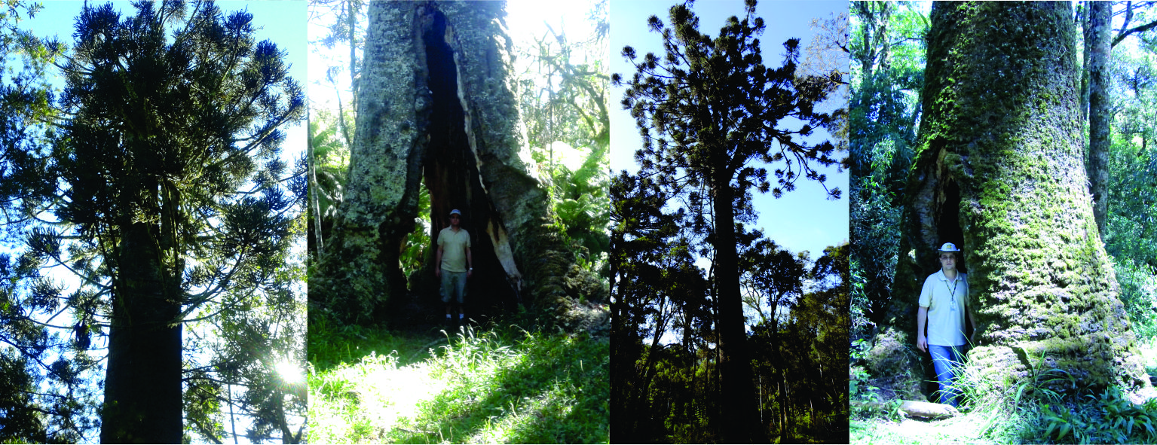
The results presented here is catalog of biggest araucarias:
giant araucarias with > 2.00 m in diameter are rare and only 13 individuals
a priority action of governments is to recognize and preserve the monumental trees and their genetic resources;
a need for a public policy of specific forest inventories of large trees
and to initial a discussion about age estimation, especially the giant ones where all had big cavities.
Conclusions

Slide 30
Muito obrigado pela atenção!
E-MAIL: marcelo.scipioni@gmail.com
www.arvoresgigantes.org

